Slide 1
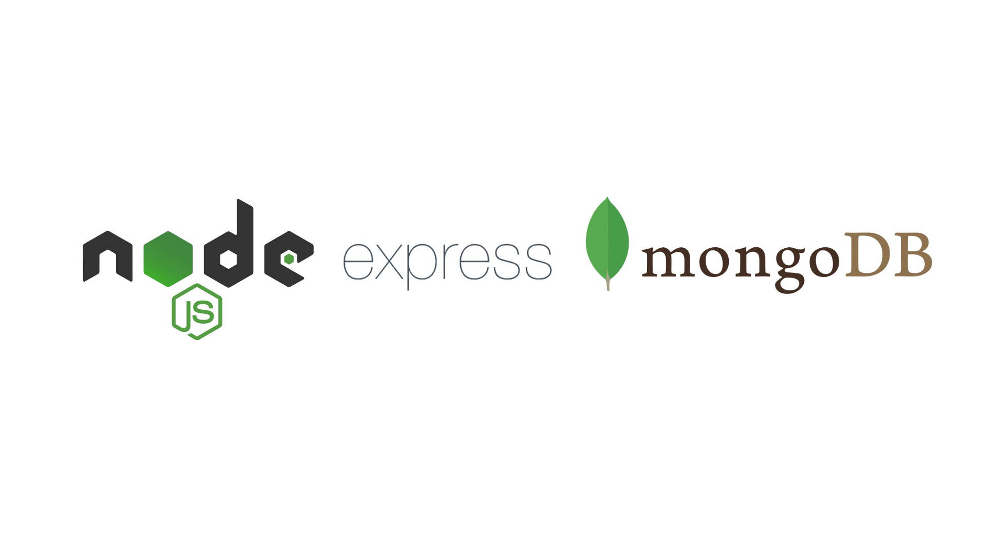
Hands-on training in
By,
Ranjani
Senior Software Engineer
PSG Software Technologies

Slide 2
Agenda
Synchronous vs Asynchronous JS
Introduction to Node
Introduction to Express
Introduction to MongoDB
Application Development

Slide 3
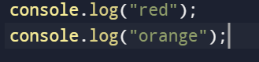
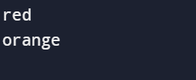
Synchronous vs Asynchronous
Synchronous :
Every statement of the code gets executed one by one
Statement 2 has to wait until statement 1 is completed.

Slide 4
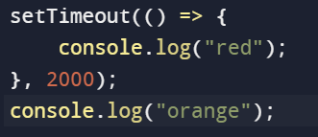
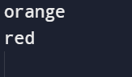
Synchronous vs Asynchronous Contd…
Asynchronous :
Allows the program to continue running while waiting for a task to finish

Slide 5
Callback
It is a function that is passed as an argument to another function that executes the callback based on the result.
Callback functions are executed only after a result is produced.
Callback Hell -> nested callbacks stacked below one another forming a pyramid structure.
Every callback depends/waits for the previous callback.
It affects the readability and maintainability of the code.

Slide 6
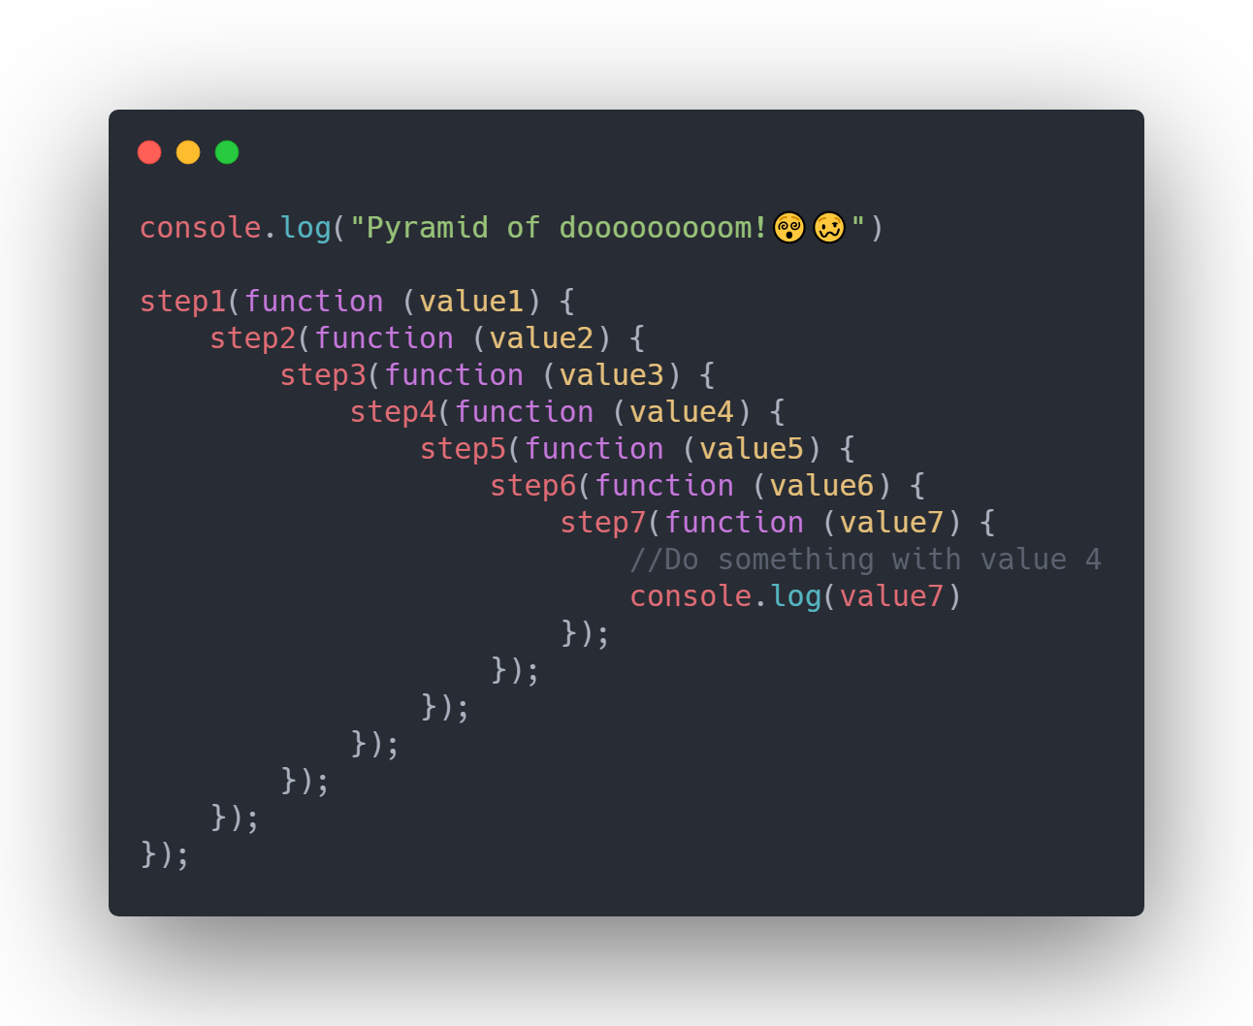
Callback hell

Slide 7
Promises
It represents the eventual completion / failure of an async operation.
Instead of immediately returning the value, the async method returns a promise to supply the value at some point in the future.
A Promise is in one of these states:
pending: initial state, neither fulfilled nor rejected.
fulfilled: meaning that the operation was completed successfully.
rejected: meaning that the operation failed.
settled: promise has been fulfilled or rejected

Slide 8
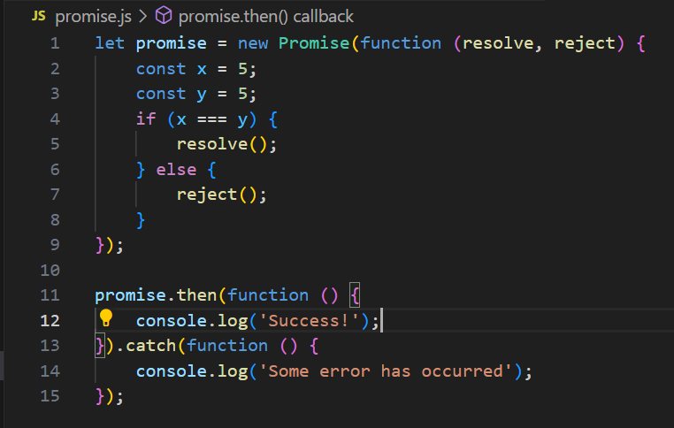
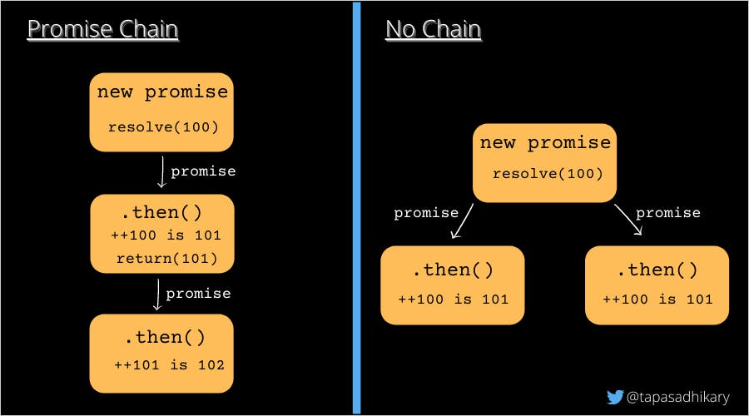
Promise chaining

Slide 9
Async / Await
Async and await make promises easier to write
It allows to write promises-based code as if it was synchronous and it checks that we are not breaking the execution thread.
Async functions will always return a value.
Async makes a function return a Promise
Await makes a function wait for a Promise

Slide 10
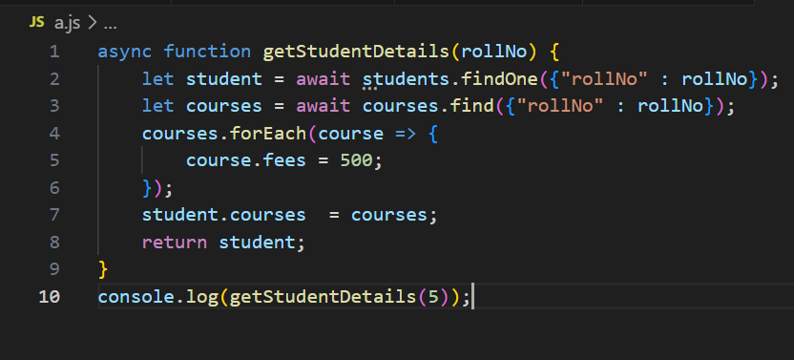
Async / Await Contd…

Slide 11
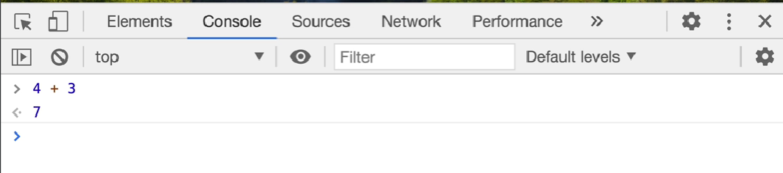
Introduction to Node
How to run JS?
Run js code in browser.
Open developer tools Ctrl + Shift + I / Right click -> Inspect -> console
Browser is embedded with JS engine.

Slide 12
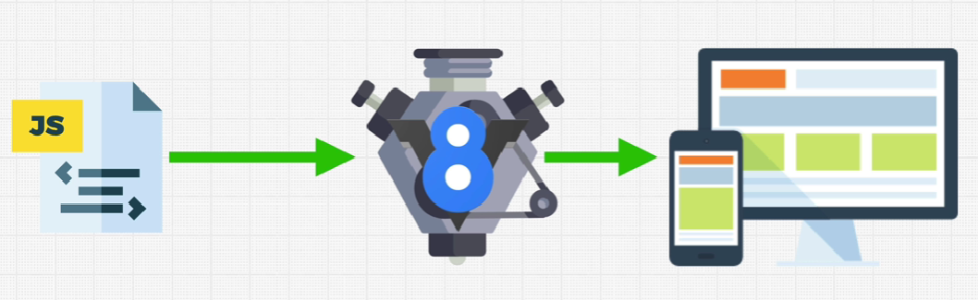
What is JS Engine ?
JS engine help to convert our JS program into computer-understandable language.
Notes:
V8 is a JavaScript engine developed by the Chromium Project for Google Chrome and Chromium web browsers. It is a JavaScript engine that can run standalone, or be embedded into any C++ application. Using its own parser, it generates an abstract syntax tree. Then, Ignition generates bytecode from this syntax tree using the internal V8 bytecode format. Bytecode is compiled into machine code by TurboFan. It also handles memory allocation for objects, and garbage collects objects it no longer needs.

Slide 13
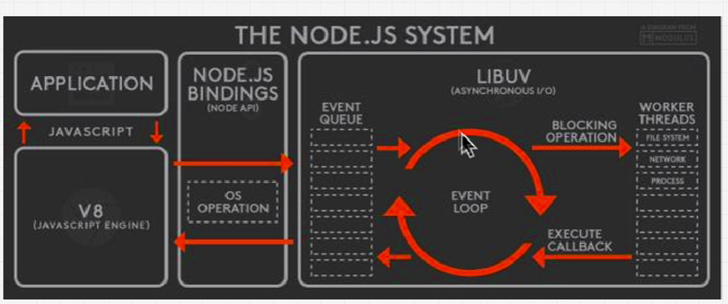
Nodejs -> An open source JS run time environment that allows to write JS program that interacts with different libraries other than the browser.
Notes:
Nodejs binding -> C++ library. That binds 2 different programming languages. Node.js bindings are series of methods that can be used in Node.js code which are in reality just running C++ code behind the scenes.
fs.readFile()
This method is not part of javascript. It's provided to v8 as part of the node.js runtime. So javascript does not know how to read a file from disk but C++ does. So when we use javascript code and node.js to read a file from disk it just defers all of that to the C++ function that can actually read the file from disk and get the results back.
Libuv library that helps to improve efficiency in running tasks parallelly.

Slide 14
Features of Nodejs
Open source
Cross platform
Used to create server-side web applications
Asynchronous and Event Driven
Single threaded in nature
No buffering -> Simply output the data in chunks
Notes:
Here, when the code executes, the function print(5) will be invoked and will push into the call stack. When the function is called, it starts consoling the statement inside it but before consoling the whole statement it encounters another function add(n,n) and suspends its current execution, and pushes the add function into the top of the call stack. Now the function will return the addition a+b and then popped out from the stack and now the previously suspended function will start running and will log the output to console and then this function too will get pop from the stack and now the stack is empty. So this is how a call stack works.

Slide 15
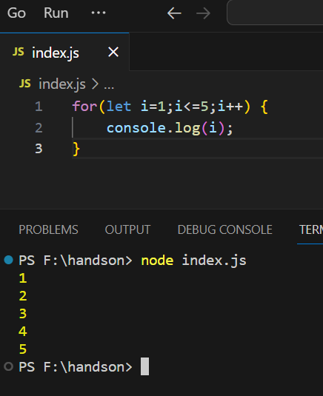
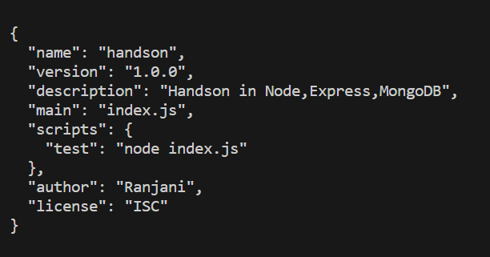
Setting up the environment
Download | Node.js
node –v => check version of node
npm init

Slide 16
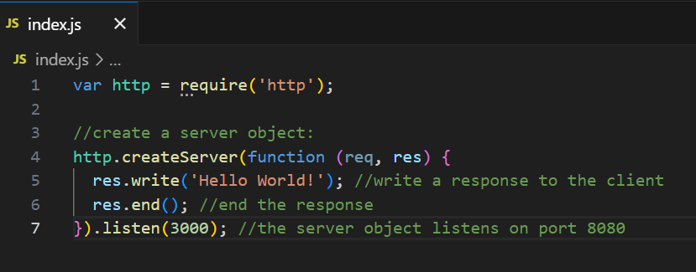
Modules
Module is a piece of reusable JavaScript code

Slide 17
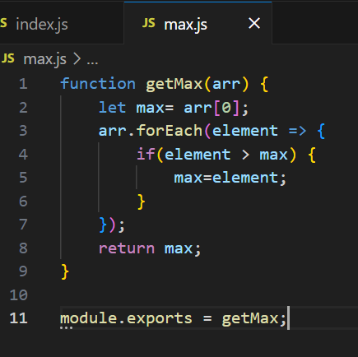
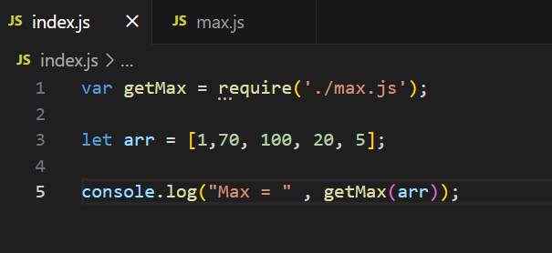
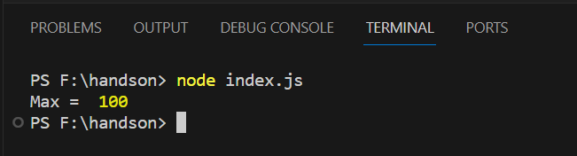
Local modules

Slide 18
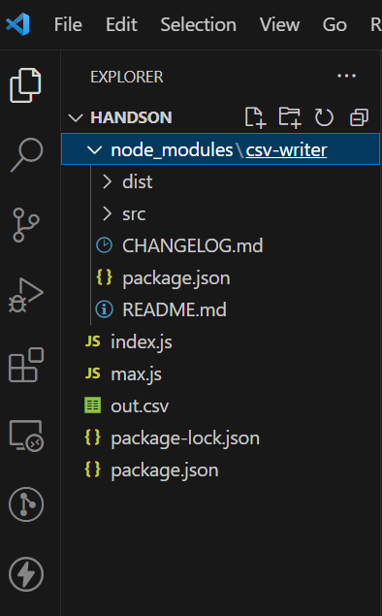
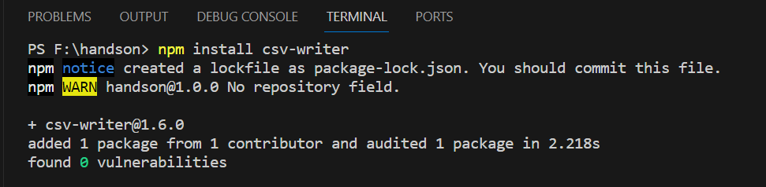
Third party modules

Slide 19
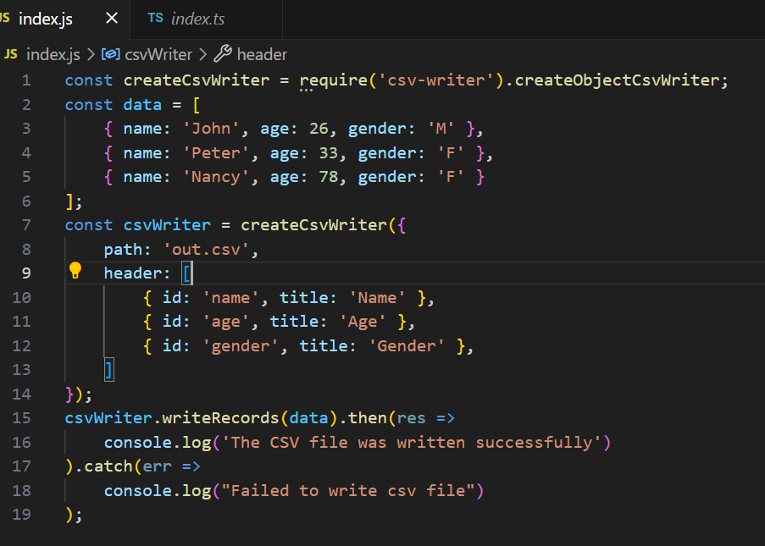

Slide 20
Introduction to Express
Framework that sits on top of Node.js’s web server functionality
Middleware: To process incoming requests before they reach their final destination.(Authentication / validation)
Routing: Handle different HTTP requests and map them to specific actions.
Templating: Makes easier to create dynamic and interactive pages.
Database Integration: Easily integrated with popular databases such as MongoDB and MySQL

Slide 21
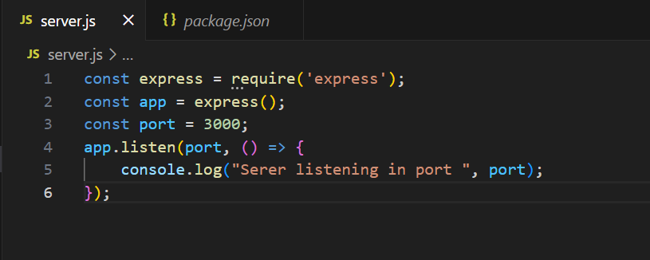
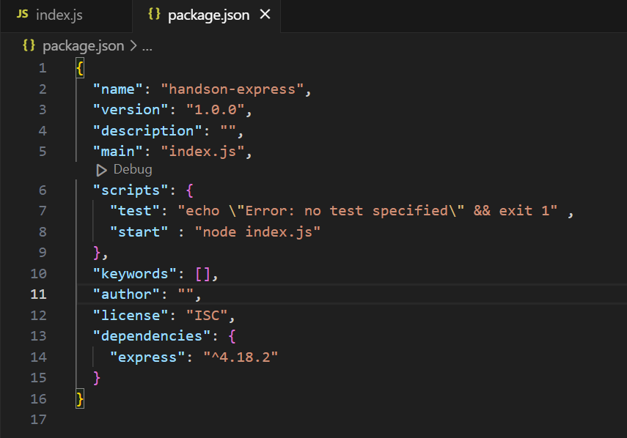
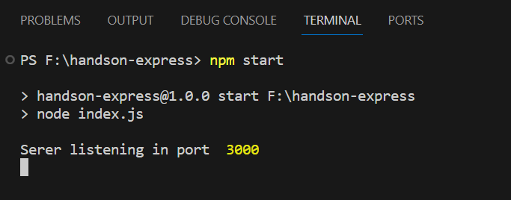
Server setup
Notes:
Goto http://localhost:3000/ -> get error

Slide 22
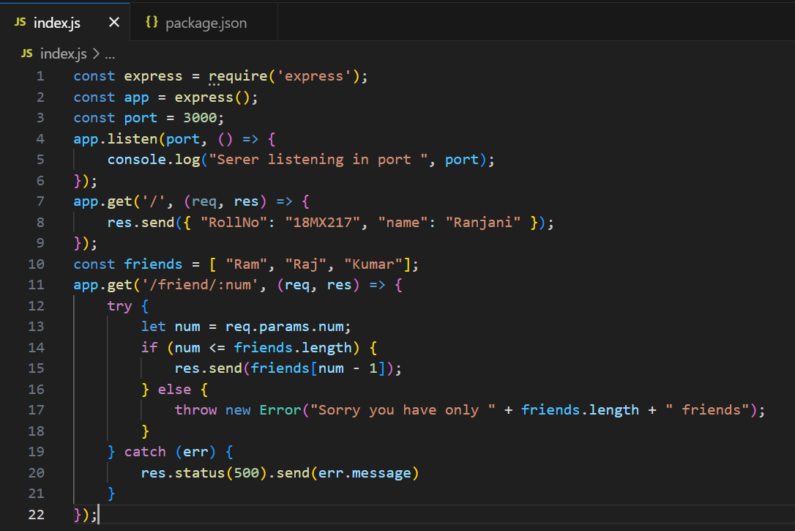

Slide 23
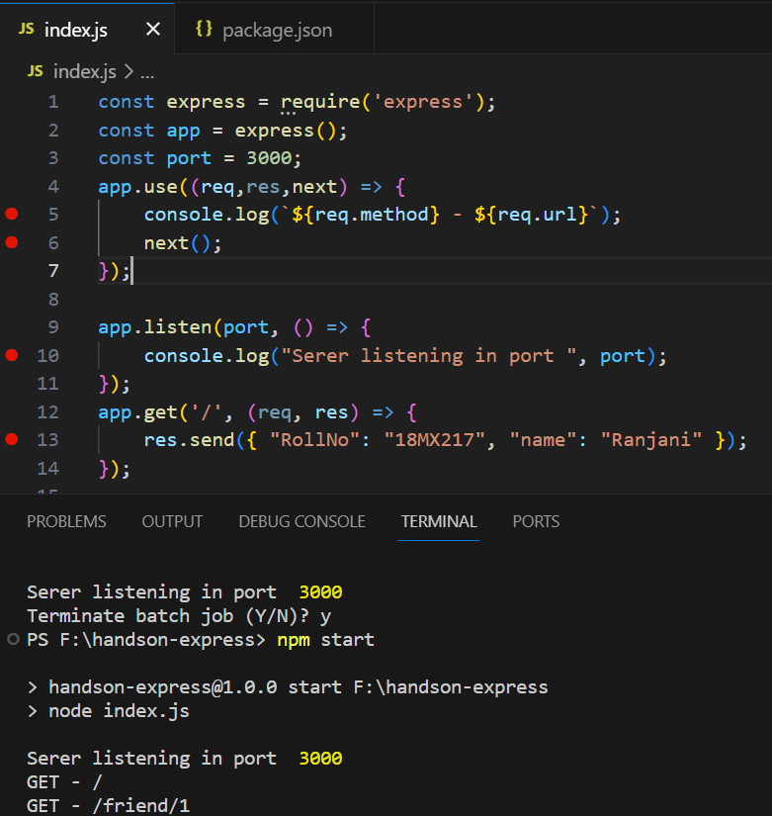
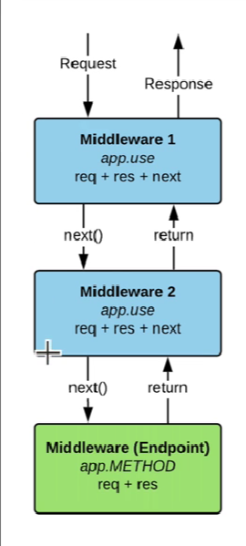
Middleware

Slide 24
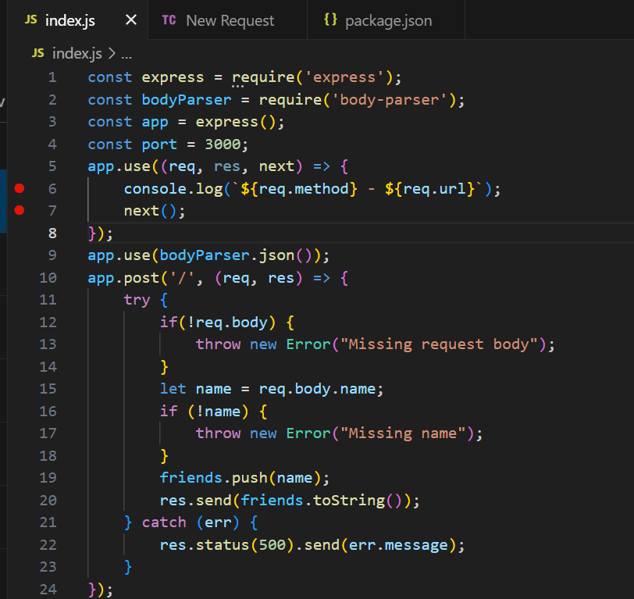

Slide 25
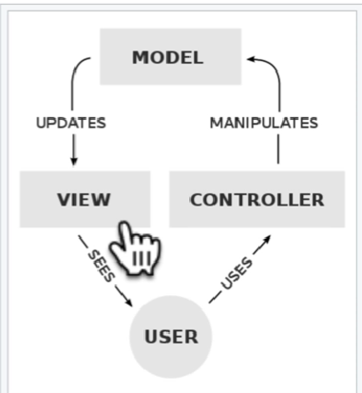
MVC pattern -> Design pattern that breaks an application into three parts: the data (Model), the presentation of data to user (View), and actions taken on user interaction (Controller).
Controller -> Takes care of client request processing
Model -> Database interface which interact with the database API and create different entity schema
View -> Response of what is requested. View needs to use a Template Engine for doing the rendering process

Slide 26
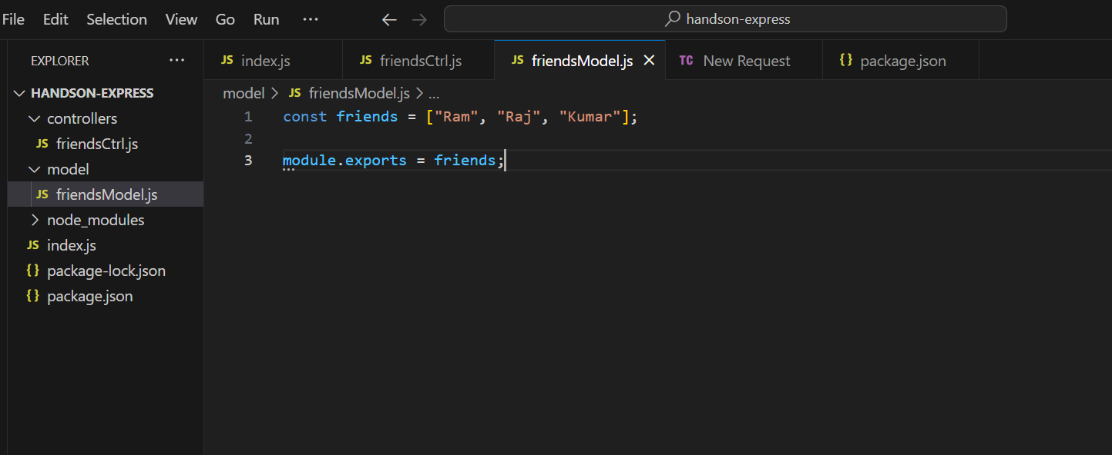
Model

Slide 27
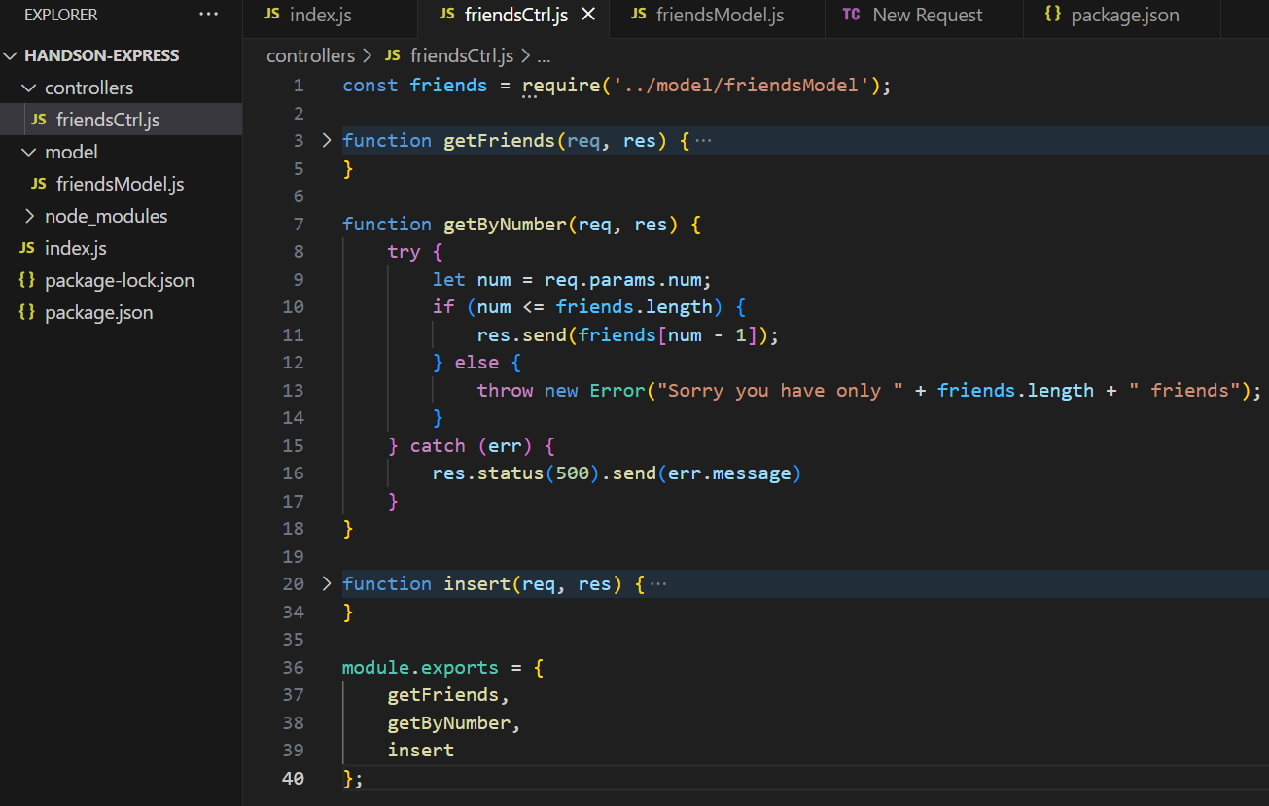
Controller

Slide 28
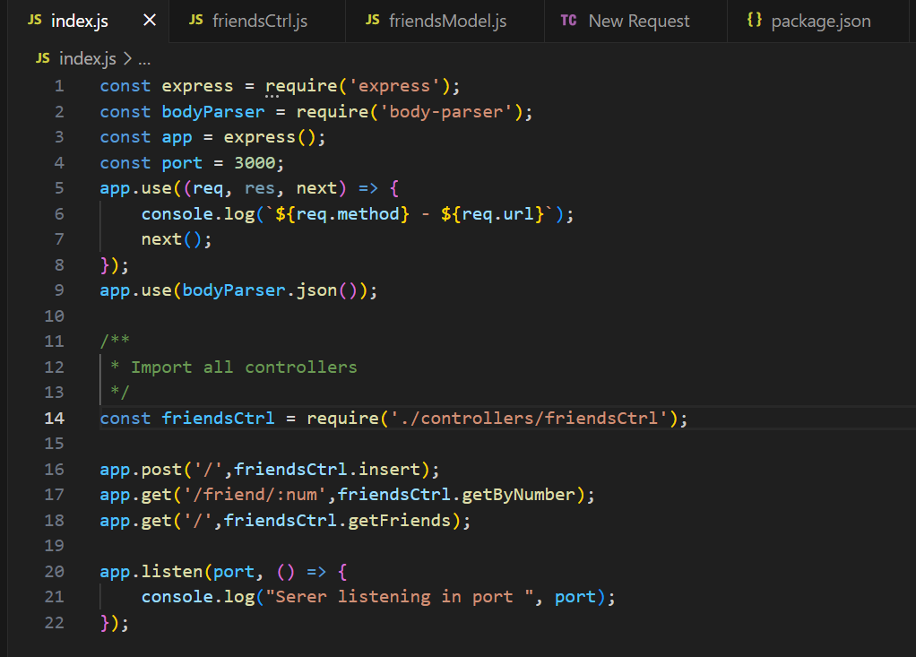
Index.js

Slide 29
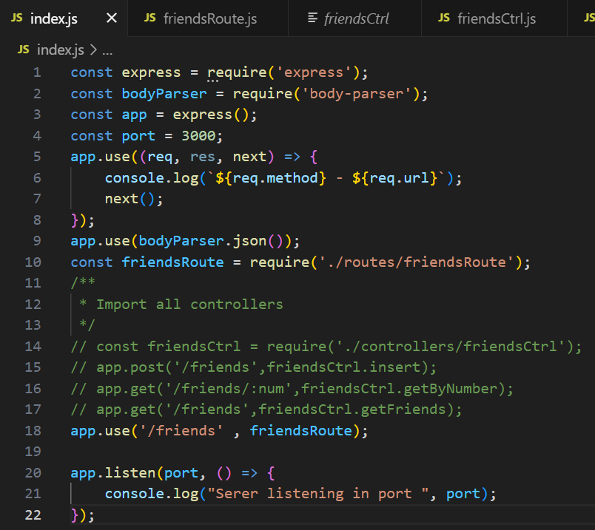
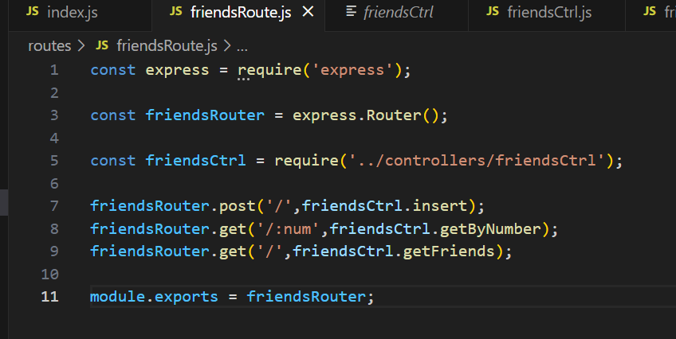
Router -> Handler functions used when the application receives a request to the specified route (endpoint)

Slide 30
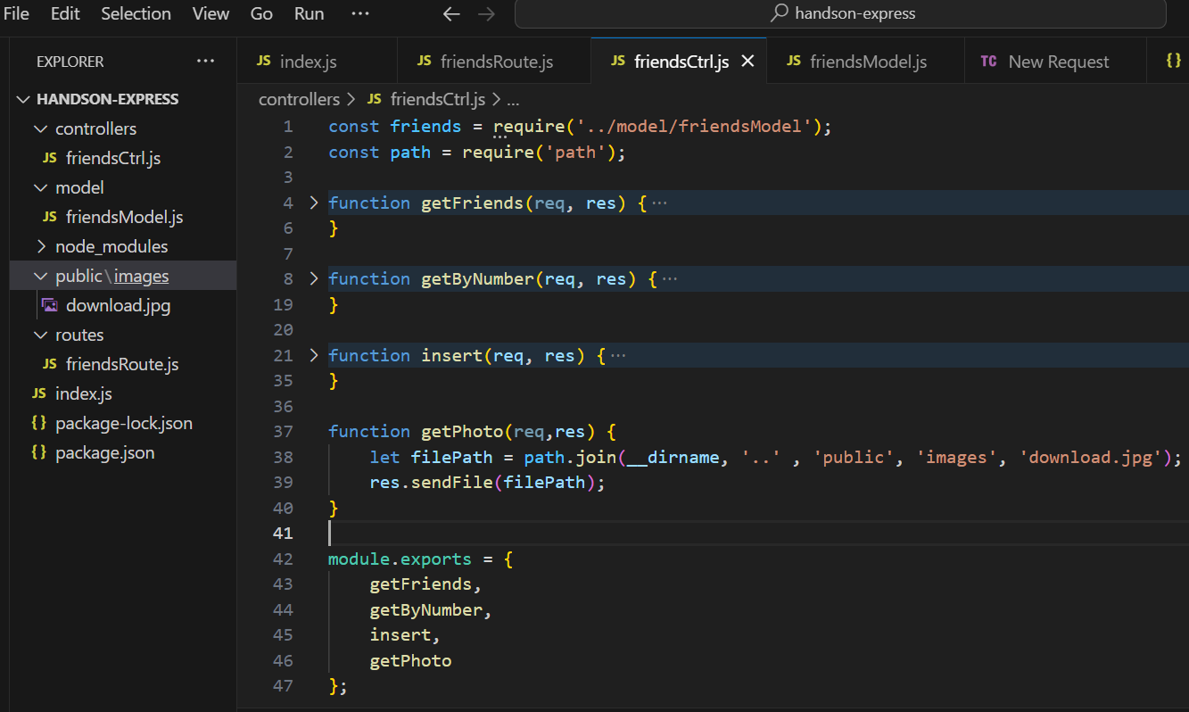

Slide 31
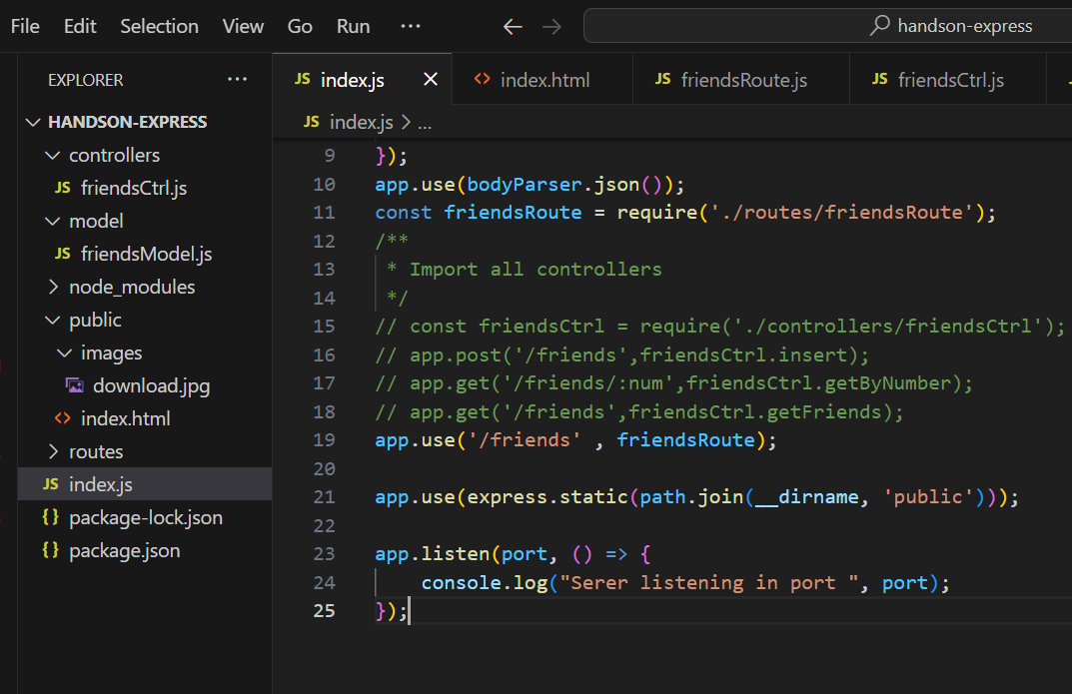
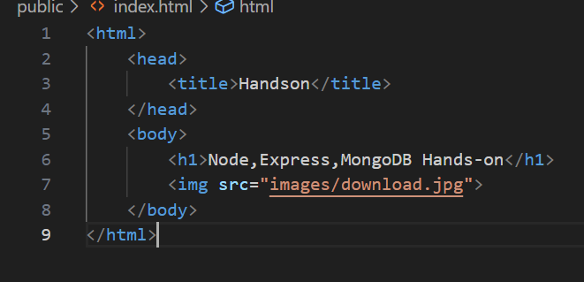
Serving files

Slide 32
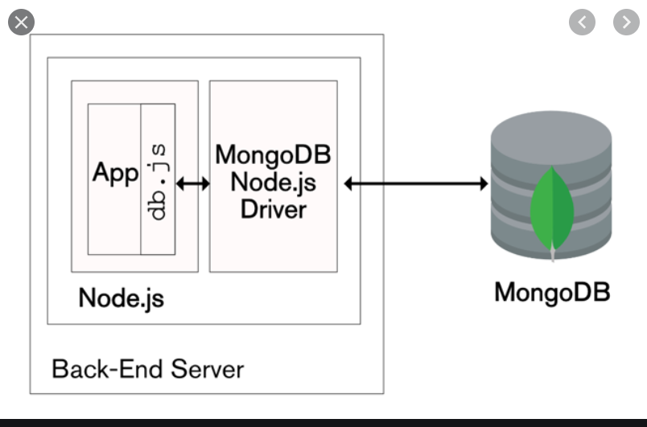
MongoDB
Document oriented database
Flexible schema
Structured and unstructured information can be stored in the same document.

Slide 33
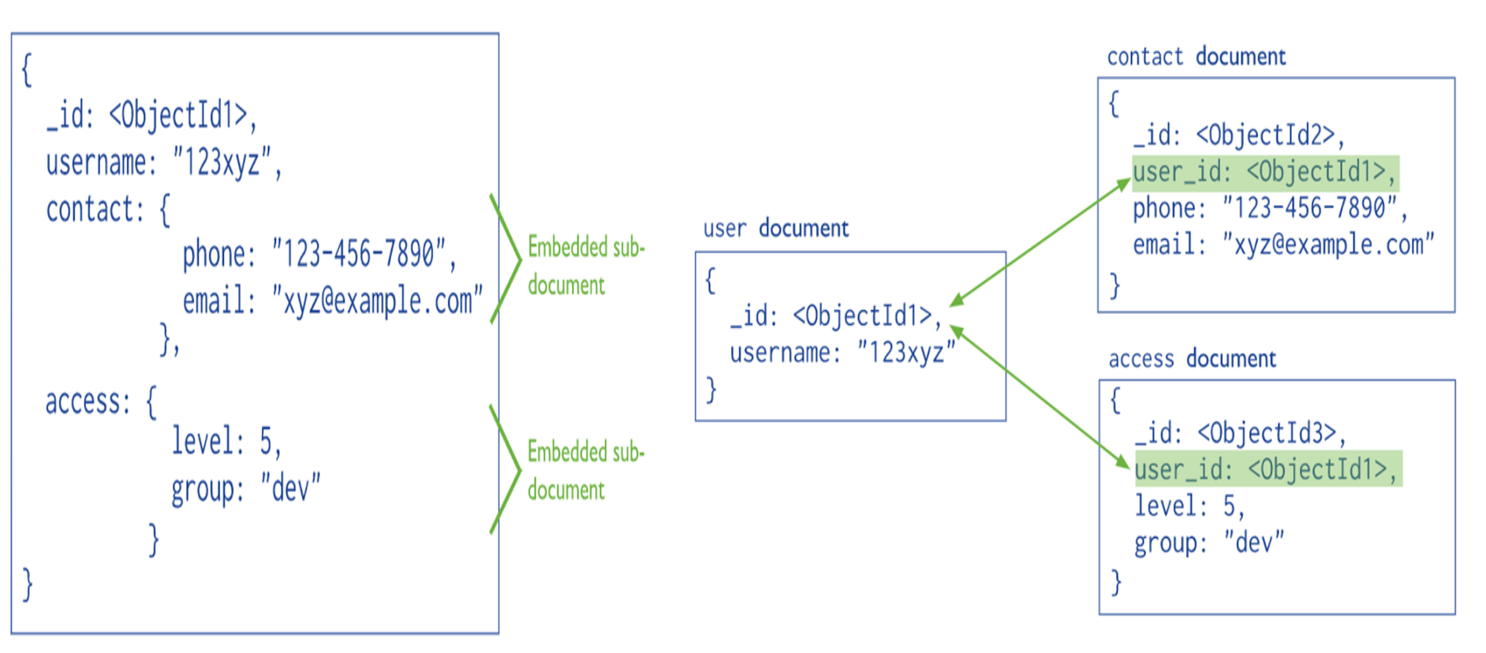
Embedded vs Normalized data modelling

Slide 34
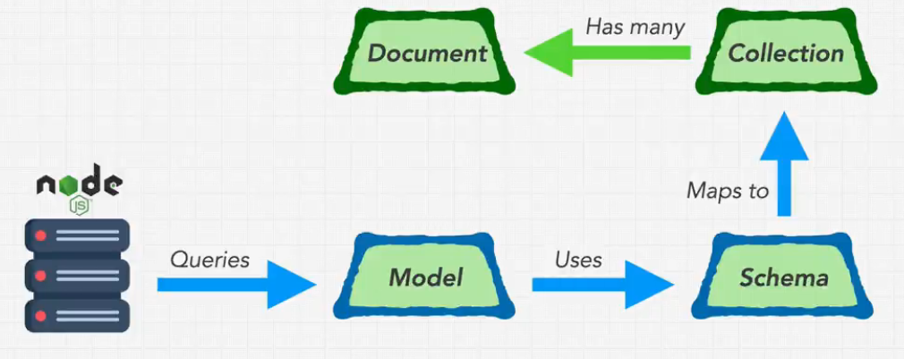
Mongoose Working Flow
Notes:
Models are defined using the Schema interface. The Schema allows you to define the fields stored in each document along with their validation requirements and default values.

Slide 35
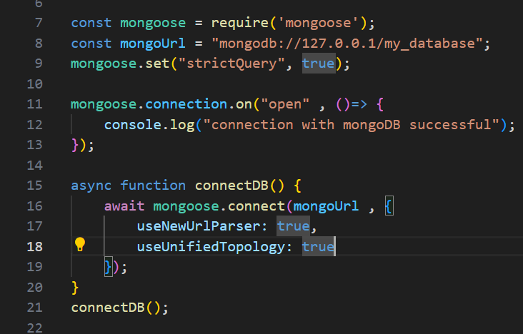
Connecting to MongoDB

Slide 36
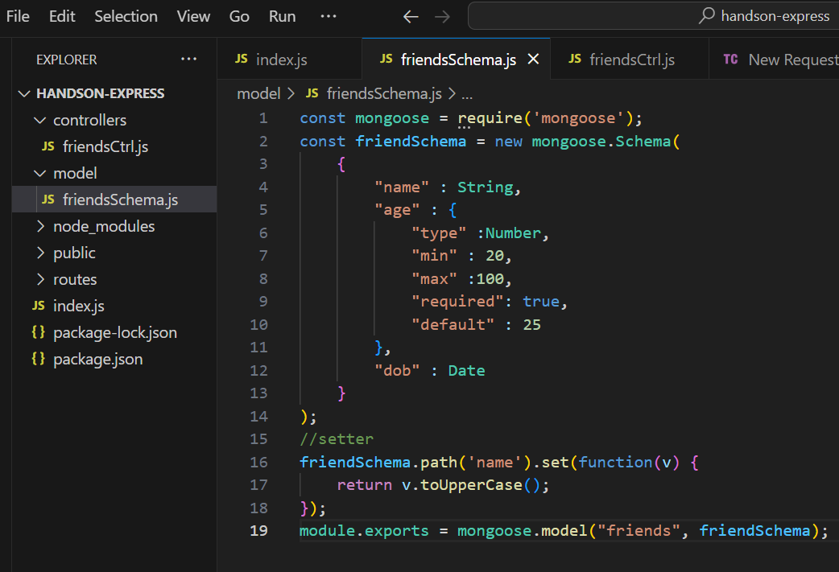
Defining Schema
Notes:
Schemas are then "compiled" into models using the mongoose.model() method.

Slide 37
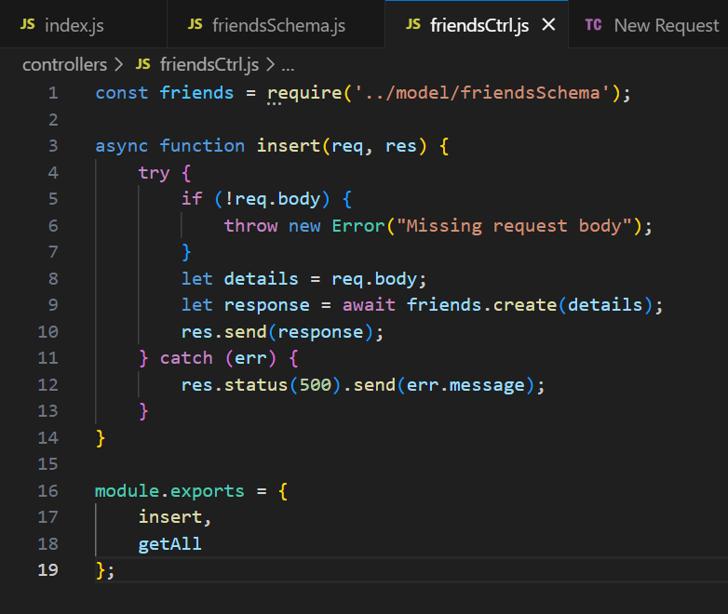
Insert Document

Slide 38
Operations
Model.find()
Model.findById()
Model.findByIdAndDelete()
Model.findByIdAndRemove()
Model.findByIdAndUpdate()
Model.findOne()
Model.findOneAndDelete()
Model.findOneAndUpdate()
Model.updateMany()
Model.updateOne()
Model.deleteMany()
Model.deleteOne()
Model.aggregate()
Model.bulkWrite()
Model.count()
Model.distinct()

Slide 39
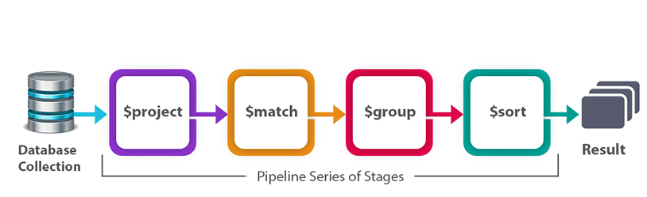
Aggregation
Process multiple documents and return computed results.
Pipeline consists of one or more stages that process documents.
Each stage performs an operation on the input documents.
The documents that are output from a stage are passed to the next stage.

Slide 40
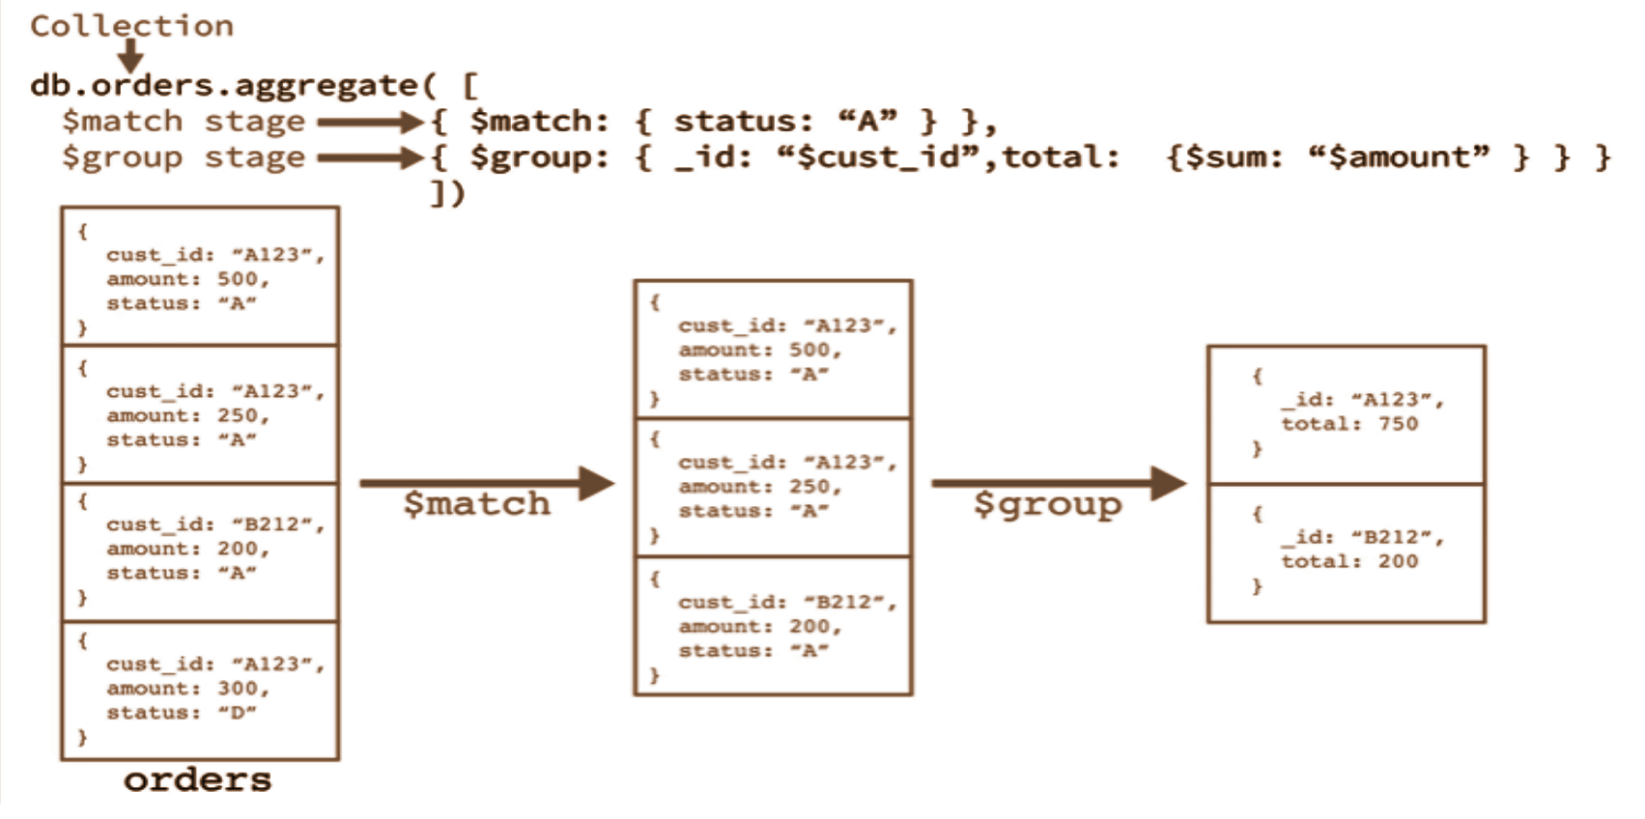
Pipeline

Slide 41
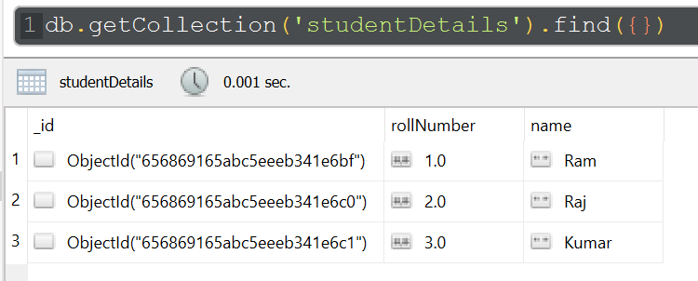
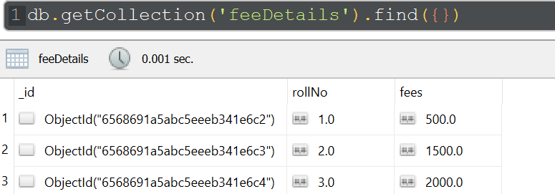
Lookup

Slide 42
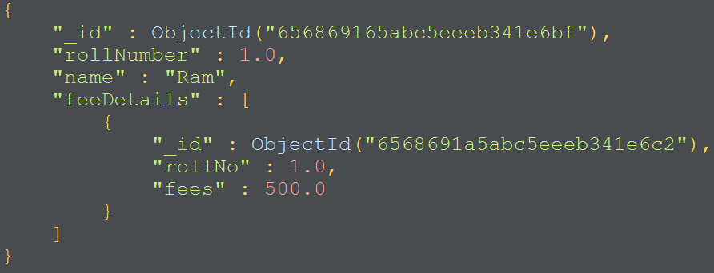
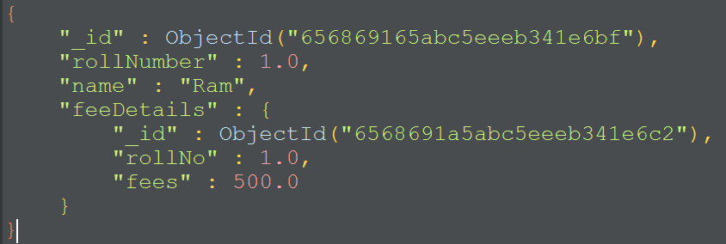
db.studentDetails.aggregate(
[
{
$project : { "rollNumber" : 1, "name" : 1}
},
{
$lookup: {
from: "feeDetails",
localField: "rollNumber",
foreignField: "rollNo",
as: "feeDetails",
},
},
{
$unwind: "$feeDetails"
},
{
$project: {"rollNumber": 1, "name" :1, "fees" : "$feeDetails.fees" }
}
]);

Slide 43
Application Development
Build a simple login and registration system with a dashboard that shows users’ information with two actions.
View messages
Post message (Should show only for the user who logged in)

Slide 44
Identify the Use Cases Routes Required (Ctrl)
Registration
Login
List users
Post a message
View messages
Post -> /user/register
Post -> /user/login
Get -> /user
Post -> /messages
Get -> /messages

Slide 45
Identify the Model Identify the Views
Users :
userName (unique)
name
email
age
password
Messages :
userName
message
postedOn
Registration page
Login page
Dashboard page
Post a message page
View messages page

Slide 46
Steps
Open up your terminal in an empty folder npm init
npm install express mongoose
Create three folders to represent MVC: models, views, and controllers.
Create an index.js file in the root directory.
Go to the package.json file and edit the scripts "start": "node index.js“
Create Express server
Create model for users, messages collection
Write routers & controllers for user, messages
Connect with UI

Slide 47
References
https://blog.logrocket.com/building-structuring-node-js-mvc-application/
https://developer.mozilla.org/en-US/docs/Learn/Server-side/Express_Nodejs/Introduction
https://www.mongodb.com/docs/manual/crud/

Slide 48
Queries ?

